Slide 1


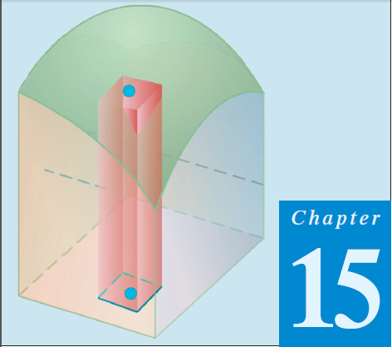
Thomas Calculus 11th
10
Double Integral In Polar Coordinate
Samuel Lukas

Slide 2
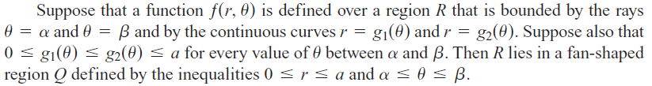
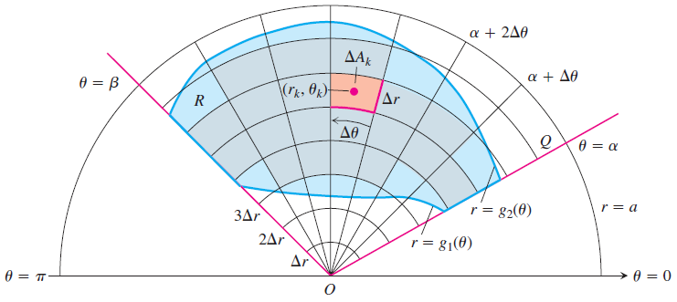

Double Integrals in Polar Coordinates

Slide 3
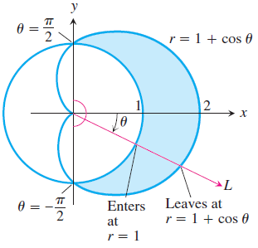

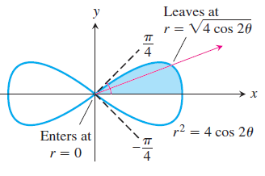




Examples 1

Slide 4



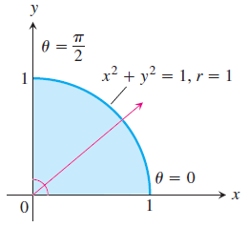


Changing Cartesian → Polar Integrals
an integral difficult to evaluate without tables.

Slide 5
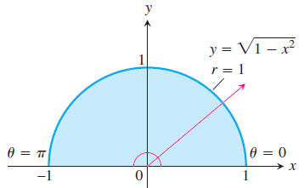



Example 2

Slide 6





Exercises
In Exercises 1–4, change the Cartesian integral into an equivalent polar integral. Then evaluate the polar integral.
1.
2.
3.
4.
5.
6.

